Slide 1
Data Interpretation

Slide 2
Data Interpretation is one of the easy sections of one day competitive Examinations. It is an extension of Mathematical skill and accuracy. Data interpretation is nothing but drawing conclusions and inferences from a comprehensive data presented numerically in tabular form by means of an illustration, viz. Graphs, Pie Chart etc. Thus the act of organizing and interpreting data to get meaningful information is Data Interpretation.
SOME USEFUL TIPS :
1 . Data Interpretation questions are based on information given in tables and graphs. These questions test your ability to interpret the information presented and to select the appropriate data for answering a question.
2 . Get a general picture of the information before reading the question. Read the given titles carefully and try to understand its nature.
3 . Avoid lengthy calculations generally, data interpretation questions do not require to do extensive calculations and computations. Most questions simply require reading the data correctly and carefully and putting them to use directly with common sense.
4 . Breakdown lengthy questions into smaller parts and eliminate impossible choices.

Slide 3
5 . Use only the information given and your knowledge of everyday facts, such as the number of hours in a day, to answer the questions based on tables and graphs.
6 . Answer the questions asked and not what you think the questions should be.
7 . Be careful while dealing with units.
8 . To make reading easier and to avoid errors observe graphs keeping them straight.
9 . Be prepared to apply basic mathematical rules, principles and formulae. 10. Since one of the major benefits of graphs and tables is that they present data in a form that enables you to readily make comparisons, use this visual attribute of graphs and tables to help you answer the questions. Where possible, use your eyes instead of your computational skills.

Slide 4
TABLES
• Tables are often used in reports, magazines and newspaper to present a set of numerical facts. They enable the reader to make comparisons and to draw quick conclusions. It is one of the easiest and most accurate ways of presenting data. They require much closer reading than graphs of charts and hence are difficult and time consuming to interpret. One of the main purposes of tables is to make complicated information easier to understand. The advantage of presenting data in a table is that one can see the information at a glance. While answering questions based on tables, carefully read the table title and the column headings. The title of the table gives you a general idea of the type and often the purpose of the information presented. The column headings tell you the specific kind of information given in that column. Both the table title and the column headings are usually very straight forward.

Slide 5
GRAPHS
There may be four types of graphs:
1) Circle Graphs: Circle graphs are used to show how various sectors are in the whole. Circle graphs are sometimes called Pie Charts. Circle graphs usually give the percent that each sector receives In such representation the total quantity in question is distributed over a total angle of 360°. While using circle graphs to find ratios of various sectors, don't find the amounts each sector received and then the ratio of the amounts. Find the ratio of the percentages, which is much quicker.
2)Line Graphs: Line graphs are used to show how a quantity changes continuously. If the line goes up, the quantity is increasing; if the line goes down, the quantity is decreasing; if the line is horizontal, the quantity is not changing.
3) Bar Graphs: Given quantities can be compared by the height or length of a bar graph. A bar graph can have either vertical or horizontal bars. You can compare different quantities or the same quantity at different times. In bar graph the data is discrete. Presentation of data in this form makes evaluation of parameters comparatively very easy.

Slide 6
4) Cumulative Graphs : You can compare several categories by a graph of the cumulative type. These are usually bar or line graphs where the height of the bar or line is divided up proportionally among different quantities.
CONCEPT TO REVISE:
Average = Sum of observations/Total number of observations
Percentage Increase = (Increase/Original Value)*100
Percentage Decrease = (Decrease/Original Value)*100
where, Original Value is the value to which increase and decrease has been done or the old value

Slide 7
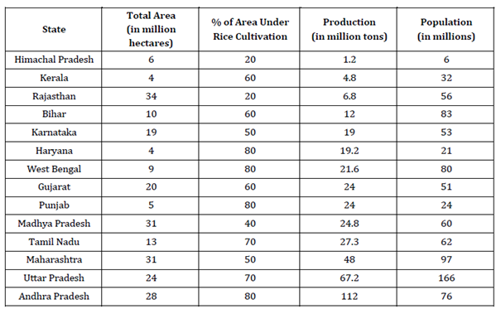
Example 1: The table below reports annual statistics related to rice production in selected states of India for a particular year:

Slide 8
Which two states account for the highest productivity of rice (tons produced per hectare of rice cultivation)?
Haryana and Punjab
Punjab and Andhra Pradesh
Andhra Pradesh and Haryana
Uttar Pradesh and Haryana
How many states have a per capita production of rice (defined as total rice production divided by its population) greater than Gujarat?
3
4
5
6

Slide 9
An intensive rice producing state is defined as one whose annual rice production per million of population is at least 400,000 tons. How many states are intensive rice producing states?(approx)
5
6
7
8

Slide 10
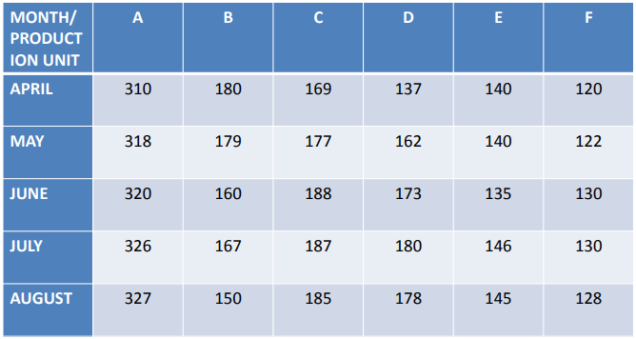
Study the following table and answer the questions given below it.
Production of sugar by six major production units of India in Million Tonnes

Slide 11
In which month the unit B has a contribution of approximately 15% in the total sugar production?
a) August
b) June
c) July
d) April
Ans: c)
Which of the following units shows continuous increase in production of sugar over months?
A
B
C
D
Ans: a

Slide 12
In the case of Unit E, in which of the following pairs of months the production of sugar was equal?
April & June
June & July
July & August
April & May
Ans:d)
In the month of June, how many units have a share of more than 25% of the total production of sugar?
one
Three
Two
Four
Ans: a

Slide 13
What was approximate percentage decrease in sugar production of unit B in June as compared to April?
8 %
10%
15%
18%
Ans:b)

Slide 14
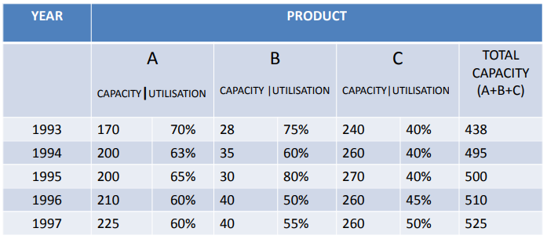
The table below gives the production capacity (in thousands units) and the percent utilisation in respect of three products (A,B and C) over five years for an organisation. Study the table carefully and answer the questions that follow.

Slide 15
Approximately, what was the overall utilization for all products taken together for the year 1993?
50%
55%
60%
65%
What is the approximate overall growth rate in respect of total capacity for the period shown?
5 %
10%
15%
20%

Slide 16
In which of the following years was the production of product A the maximum for all period shown?
1993
1997
1996
1994
What is the average production of product B over the period shown?
21,600
24,200
34,600
28,800

Slide 17
In which of the following years was the production of product C the minimum for the period shown?
1997
1994
1993
1996

Slide 18
PIE CHART (CIRCULAR GRAPH)

Slide 19
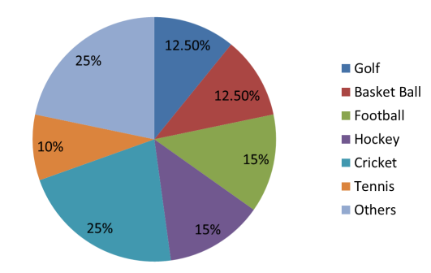
The pie-chart drawn below shows the spending of a country on various sports during a particular year. Study the pie-chart carefully and answer the questions given below it.
PERCENT OF MONEY SPENT ON VARIOUS SPORTS FOR ONE YEAR

Slide 20
If the total amount spent on sports during the year was Rs. 15000000, the amount spent on cricket and hockey together was
Rs. 2500000
Rs. 3750000
Rs. 5000000
Rs. 6000000
Out of the following, the country spent the same amount on
Hockey and Tennis
Golf and foot ball
Cricket and Foot ball
Football and Hockey
Pie-chart shows that the most popular game of the country is (on the basis of money spent)
Cricket
Foot ball
Basket ball
Hockey

Slide 21
The ratio of the total amount spent on football to that spent on hockey is
1: 15
1: 1
15:1
3: 20
Ans: b)
If the total amount spent on sports during the year was Rs. 12000000, how much was spent on basket ball?
Rs. 950000
Rs. 1000000
Rs. 1200000
Rs. 1500000
Ans: d)

Slide 22
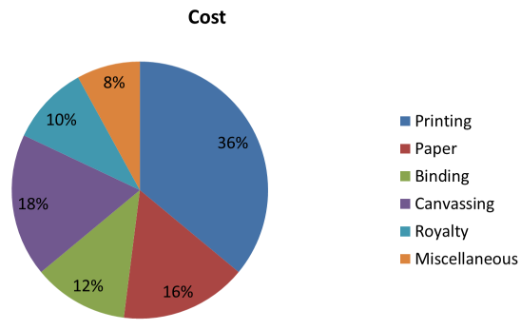
The pie chart given below shows the expenditure incurred in bringing out a book, by a publisher.

Slide 23
What is the central angle showing the cost of paper?
16°
32 °
28.8 °
57.6°
Ans: d)
If the cost of printing is Rs. 23400, the royalty is:
Rs. 6500
Rs. 2340
Rs. 4680
Rs. 7840
Ans: a)

Slide 24
If miscellaneous expenditures amount to Rs. 18000, the expenditure on canvassing will be:
Rs. 8000
Rs. 14400
Rs. 46800
Rs. 40500
Ans: d)
Royalty on the book is less than canvassing expenditure by:
8 %
80%
44 (4/9)%
None
Ans: c)

Slide 25
BAR GRAPH

Slide 26
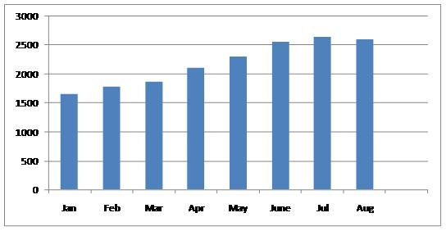
Study the following graph and answer the questions given below it.
PRODUCTIONS OVER MONTHS

Slide 27
Which of the following months shows maximum increase in the production over its immediately preceding month?
March
April
May
June
By how much is the average production of the last five months more than the average production of the first three months?
740
700
720
640

Slide 28
Which month exactly shows the same increase in production over its immediately preceding month as the month of march shows over that of February?
February
April
May
None of these
Approximately by what percentage did the total production in the two consecutive months of July and August increase over the total production in the first two consecutive months of January and February?
95
75
65
55

Slide 29
How many months have more than the average production for the 8 months period?
5
2
3
4

Slide 30
LINE GRAPH

Slide 31
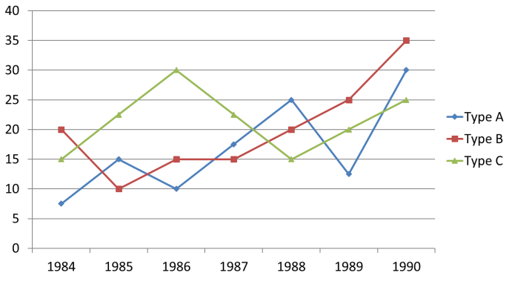
Study the following graph carefully and answer the questions given below: Production of three types of vehicles by a company over the years (in thousand)

Slide 32
What was the percentage increase in the production of C type vehicles from 1985 to1986?
10
5
20
None of these
Ans: d)
The number of A type vehicles produced in 1986 was what percent of the number of C type vehicles produced in 1988?
33 1/3
66 2/3
50
15
Ans: c)

Slide 33
In how many years was the production of A type vehicles less than its average production over the given years?
2
4
3
1
Ans: b)
What was average number of B type vehicles produced by the company over the year s?
20,000
25,000
15,000
30,000
Ans: a)

Slide 34
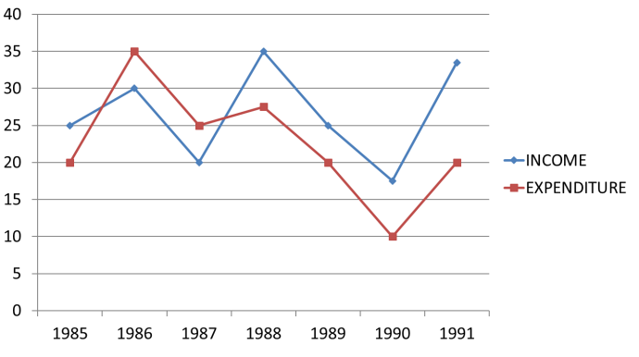
Study the following graph carefully and answer the questions given below it. Income and Expenditure of a Company over the years (Rs. in crore)

Slide 35
In which of the following years was the difference between the income and the expenditure the maximum?
1988
1991
1986
1987
Ans: b)
27. The income in 1987 was equal to the expenditure in which of the following years?
1985 only
1990 only
1985, 1989 and 1991
1988 and 1989
Ans: c)

Slide 36
What was the approximate percentage drop in expenditure from 1988 to 1989?
35
25
75
40
Ans: b)
What was the percentage increase in income from 1987 to 1988?
175
75
60
125
Ans: b)
In how many of the given years was the expenditure more than the income?
1
3
4
2
Ans: d)

Slide 37
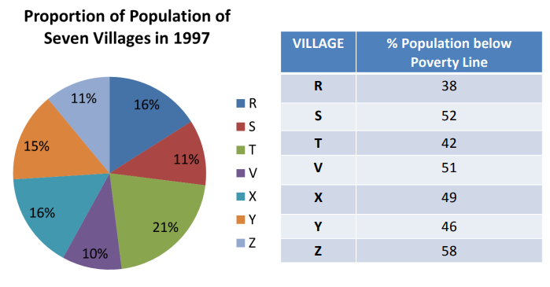
Study the following pie-chart and the table and answer the questions based on them.

Slide 38
If the population of village R in 1997 is 32000, then what will be the population of village Y below poverty line in that year?
14100
15600
16500
17000
Ans: B
The ratio of population of village T below poverty line to that of village Z below poverty line in 1997 is:
11 : 23
13 : 11
23 : 11
11 : 13
Ans: C

Slide 39
Find the population of village S if the population of village X below poverty line in 1997 is 12160.
18500
20500
22000
26000
Ans: C
If in 1998, the population of villages Y and V increase by 10% each and the percentage of population below poverty line remains unchanged for all the villages, then find the population of village V below poverty line in 1998, given that the population of village Y in 1997 was 30000.
11250
12760
13140
13780
Ans: B

Slide 40


